Slide 1

Text Classification-Arabic Dialect
By:
Abdelrahman Ahmed ALI
Submitted To:
AIM Company

Slide 2




Agenda
Proposed methodology
Introduction
State of the art
Results & Further work
Deployment

Slide 3
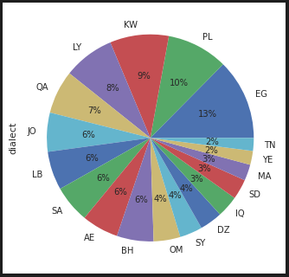
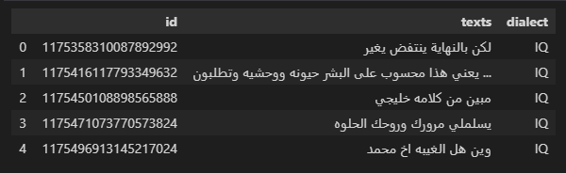
Introduction
Intuition
Dataset Arabic Dialect

Slide 4
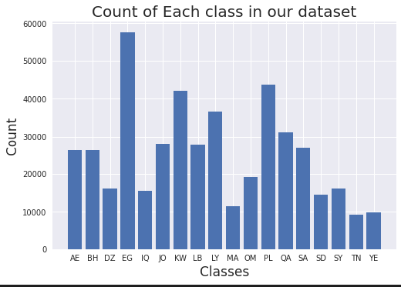
Introduction (cont.)
Abnormal Behavior Examples

Slide 5
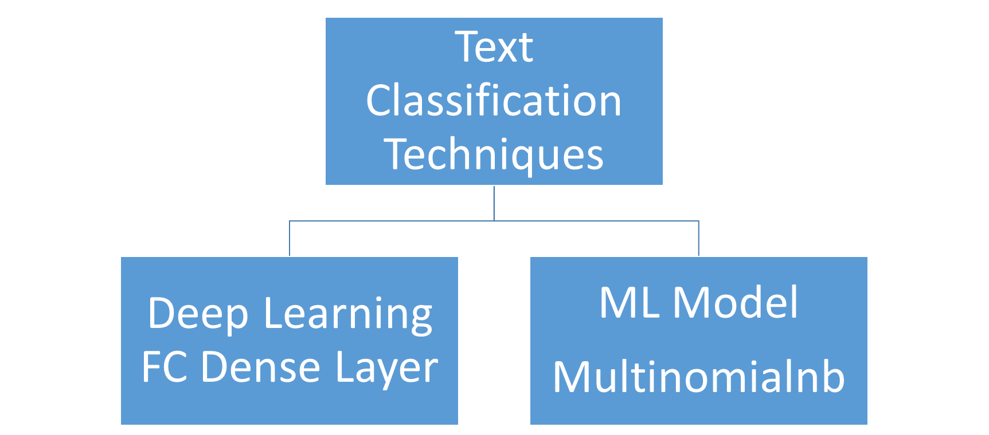
State of the art

Slide 6
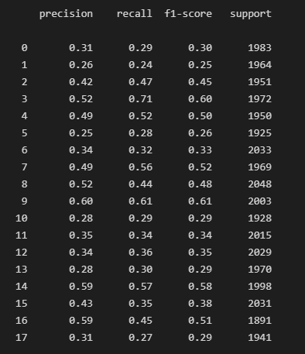
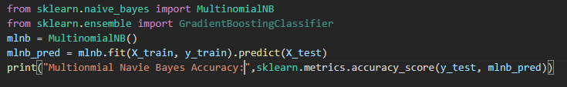
State of the art (cont.)
ML Model

Slide 7
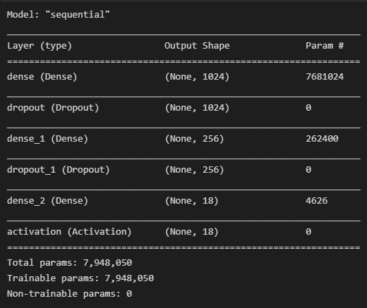
State of the art (cont.)
Deep Learning Model
ML Model MLNB | Deep Learning FC Dense
Fast in training and prediction | Slow in training and fast in prediction
Got better accuracy than Deep Learning FC | Got Lower than MLNB Model

Slide 8

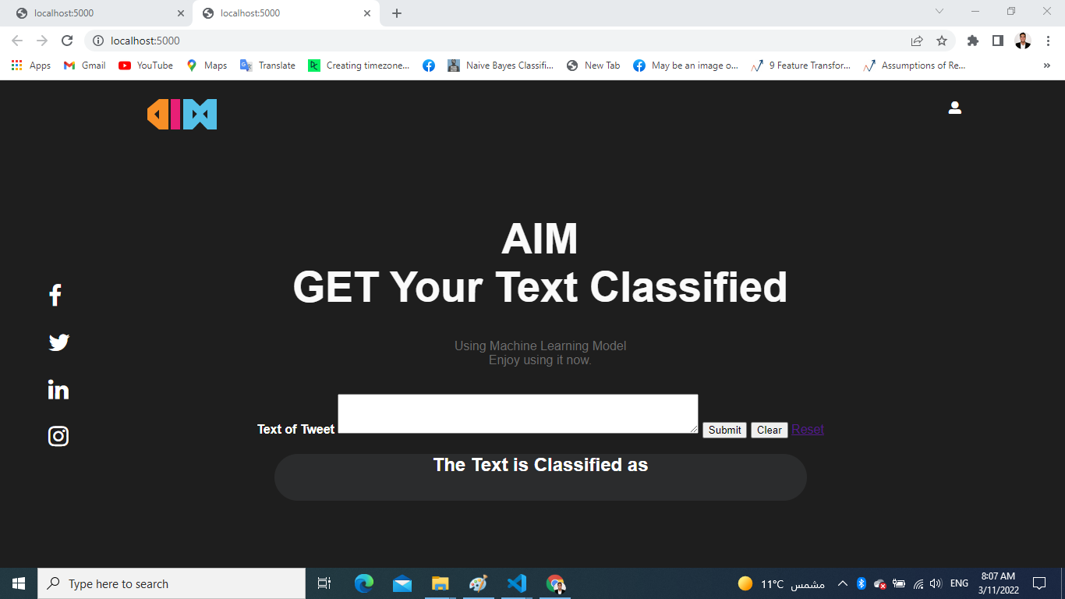
Deployment (cont.)
Web Application

Slide 9
Thank you!

